Slide 1
Financial versus Strategic Buyers
Marc Martos-Vila, Matthew Rhodes-Kropf, and Jarrad Harford (2019)
Presented by Nicholas Thompson

Slide 2
Research Question
How does debt misvaluation impact the competition between financial buyers (private equity firms) and strategic buyers (operating companies) in M&A?

Slide 3
Prior Literature
Many theories propose reasons that firms or industries may be ripe for acquisition activity (Jensen, 1986; Maksimovic & Phillips, 2001; Gorton, Kahl, & Rosen, 2009; Jovanovic & Rousseau, 2002; Mitchell & Mulherin, 1996; Lehn, Netter, & Poulsen, 1990; Mulherin & Boone, 2000; Harford, 2005).
Rhodes-Kropf and Viswanathan (2004) and Shleifer and Vishny (2003) suggest that strategic acquirers with overvalued stock will bid more, and overvalued targets are more willing to accept takeover offers.
Harford (2005) shows that interest rates are significantly inversely correlated with merger activity and argues that a low spread is a proxy for overall liquidity or ease of financing.
Prior research has not explored how debt misvaluation can fuel M&A activity and alter the balance between financial and strategic buyers.

Slide 4
Data
M&A data is from SDC Platinum database (1984–2010).
Focus is on M&A transactions with public targets valued between $10 million and $1 billion.
The authors use a novel measure of debt misvaluation to analyze how overvaluation of debt influences M&A activity and the balance between financial and strategic buyers.
Figure 1 from the paper highlights U.S. M&A volume by type of buyer (private equity vs. strategic) from 1984 to 2010.

Slide 5
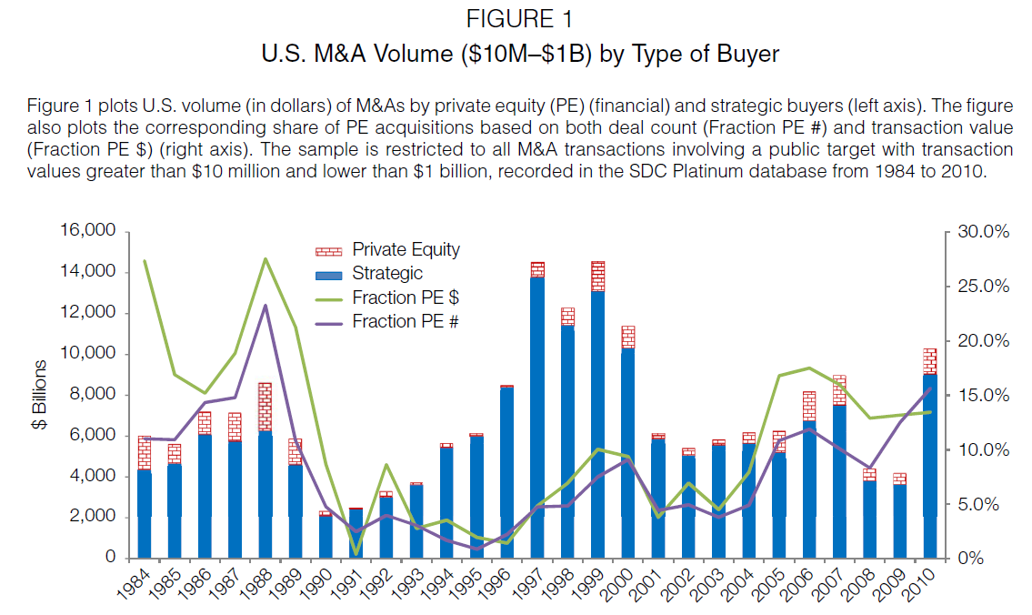
Notes:
The fraction of total deal value acquired by financial sponsors has varied dramatically over the last 25 years.
The local peaks of financial sponsor activity relative to strategic activity correspond with stock market peaks like those in the late 1990s and 2006–2007, with dips in the early 1990s and 2001 recessions.

Slide 6
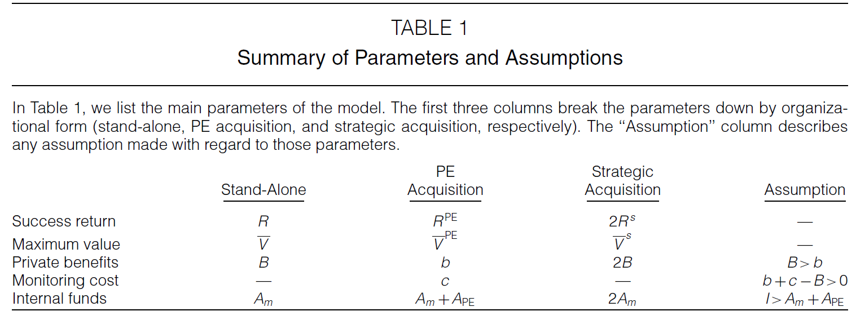

Slide 7
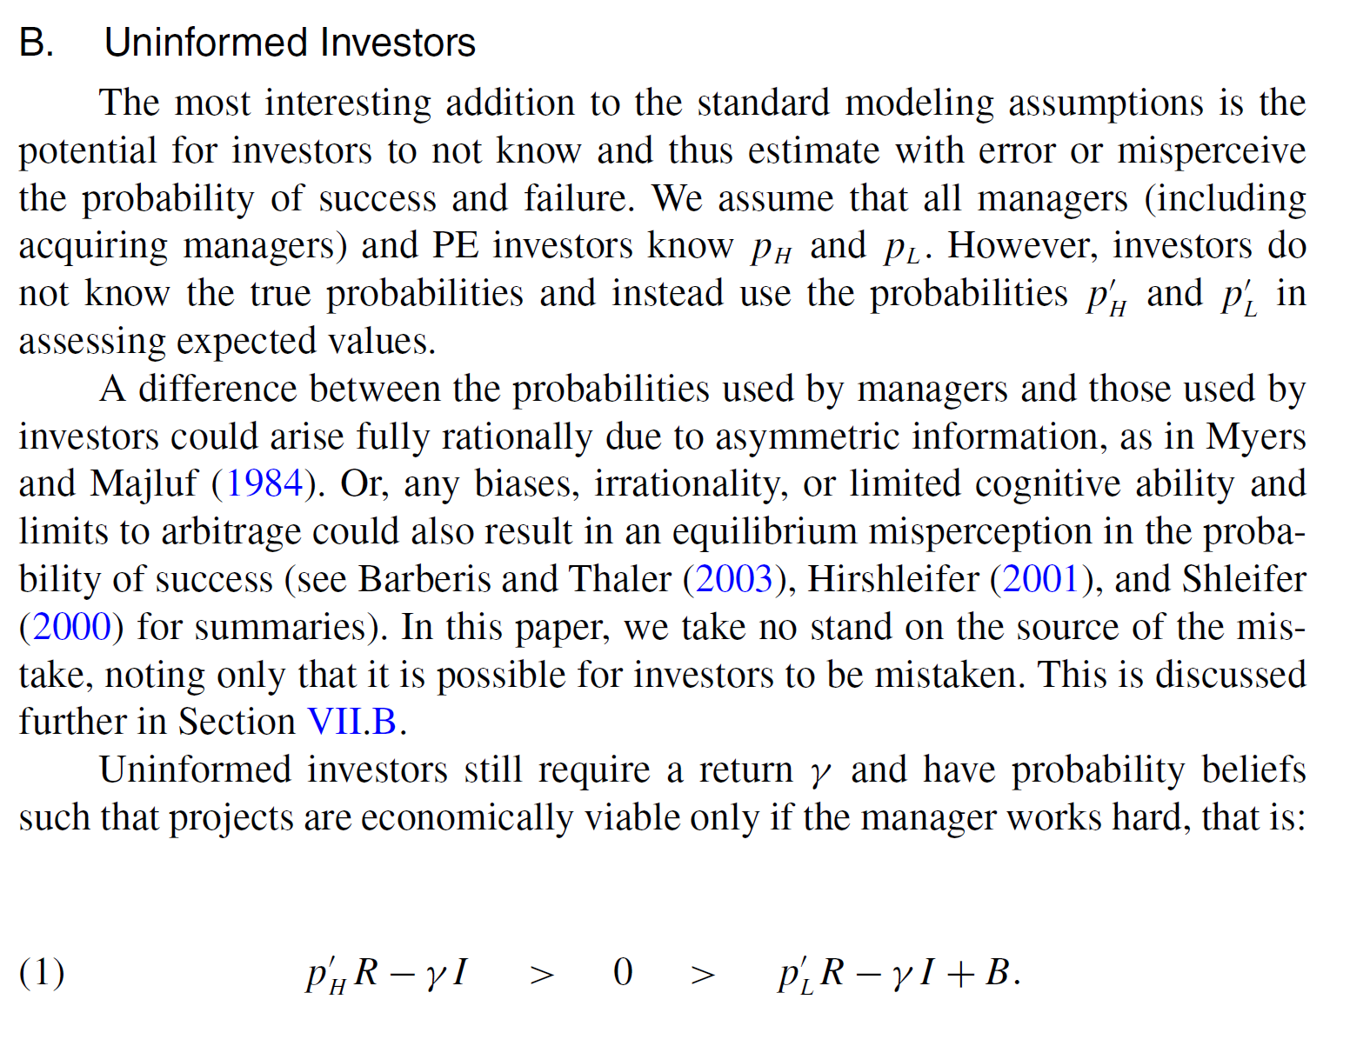
Notes:
p’H is the perceived probability that the project succeeds if the manager works hard.
p’L​ is the perceived probability that the project succeeds if the manager shirks.
R is the project’s return if successful.
I is the required investment in the project.
γ is the investors’ required return.
B is private benefits that managers gain if they shirk.

Slide 8
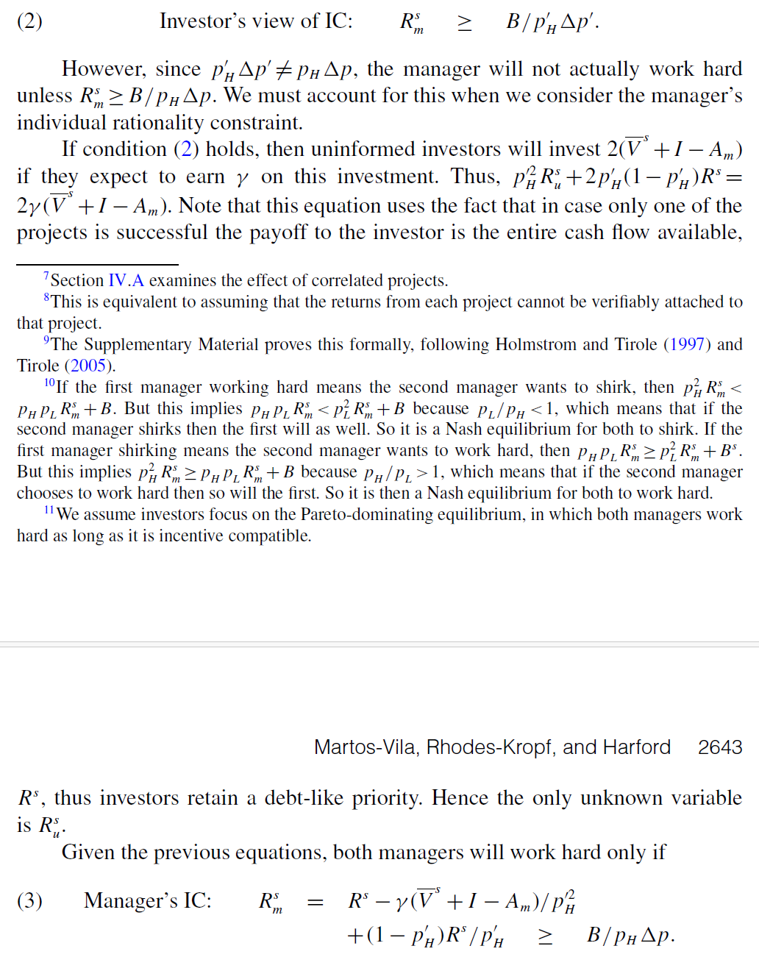
Explanation:
The novel aspect of the model is that only if the perceived incentive-compatibility (IC) constraint (equation (2)) holds will investors invest, but only if the actual IC constraint (equation (3)) holds will managers work hard.

Slide 9
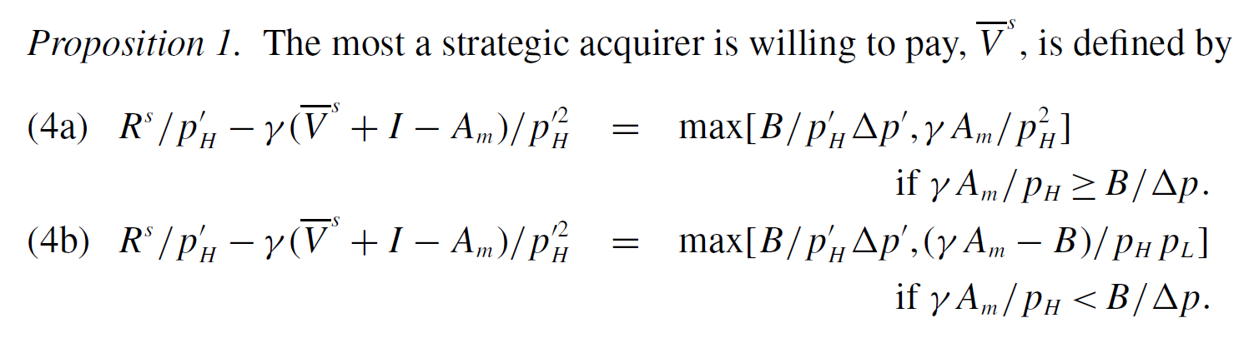
Explanation:
The strategic buyer is willing to raise its offer until a constraint binds.
In some cases, it will bind at a point where the real IC constraint is met (equation (4a)): manager works hard.
Alternatively, it will bind at a point where the real IC constraint is not met (equation (4b)): manager shirks.

Slide 10
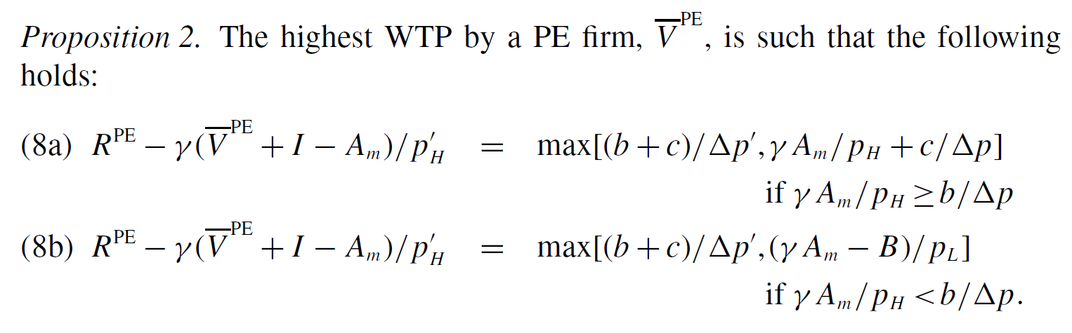
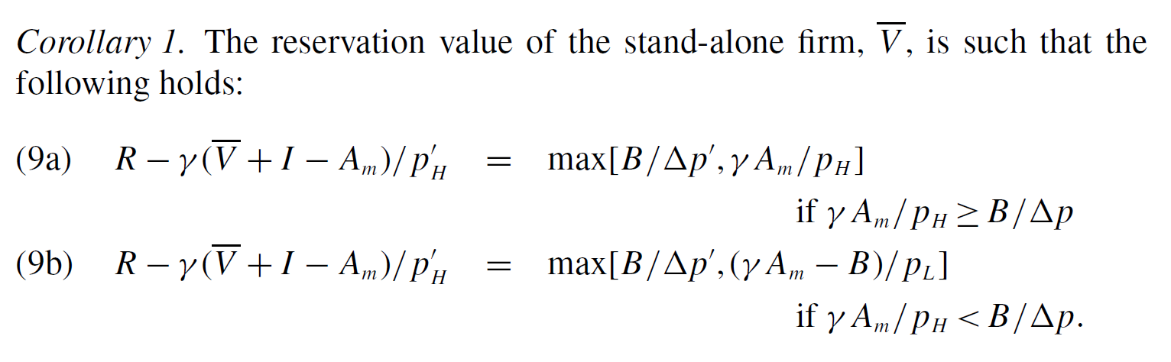
Explanation:
Follows the same logic as Proposition 1, except for PE ((8a), (8b)) and stand-alone ((9a), (9b)) firms.

Slide 11
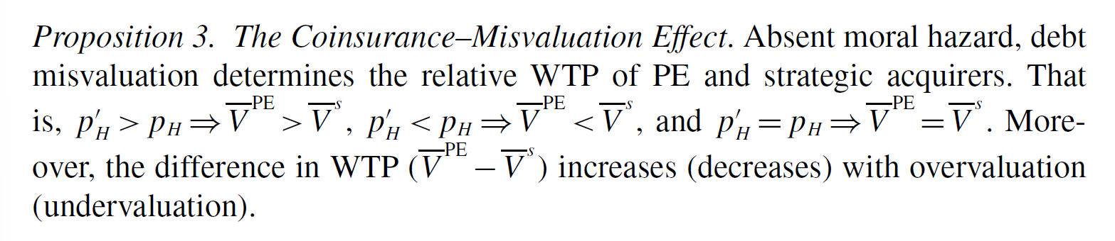
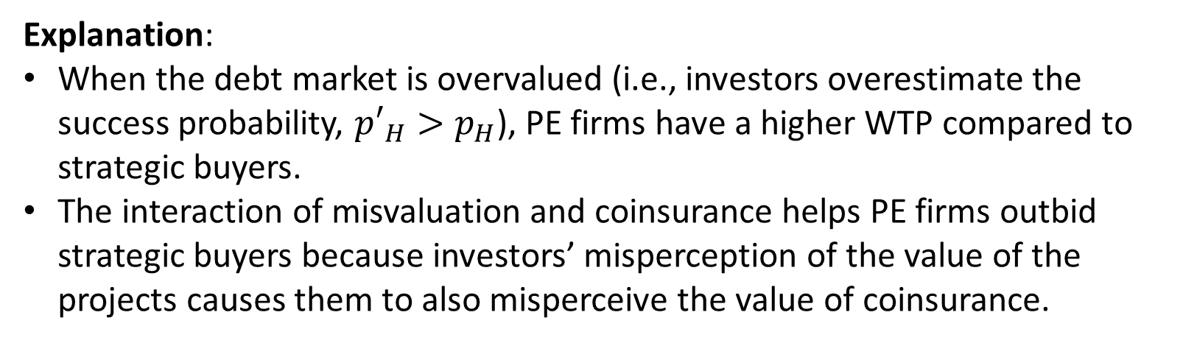
Explanation:
When the debt market is overvalued (i.e., investors overestimate the success probability, ${p′}_{H}>p_{H}$), PE firms have a higher WTP compared to strategic buyers.
The interaction of misvaluation and coinsurance helps PE firms outbid strategic buyers because investors’ misperception of the value of the projects causes them to also misperceive the value of coinsurance.

Slide 12
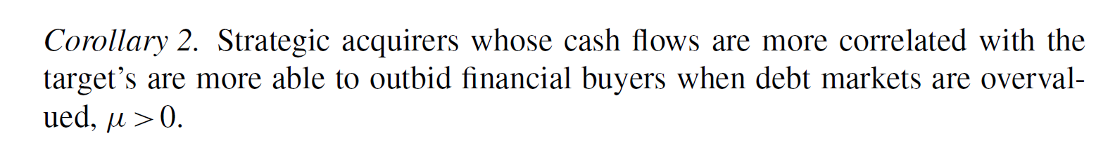
Explanation:
The relative dominance of PE should be even greater as compared to conglomerate strategic buyers (buyers from different industries) because conglomerate buyers are more diversified and should be more impacted by the coinsurance/misvaluation interaction effect.

Slide 13
Explanation:
Because misvaluation causes the investor to incorrectly perceive probabilities, a difference between the true and perceived IC constraint appears. Absent misvaluation, only the no-private-benefit project is funded in equilibrium because it is the only economically viable project. However, with misvaluation, if the perceived IC holds while the true IC does not, then a firm will be funded even though the manager shirks in equilibrium.
Equilibrium shirking is possible precisely because investors perceive the moral hazard problem to be better than it is.

Slide 14
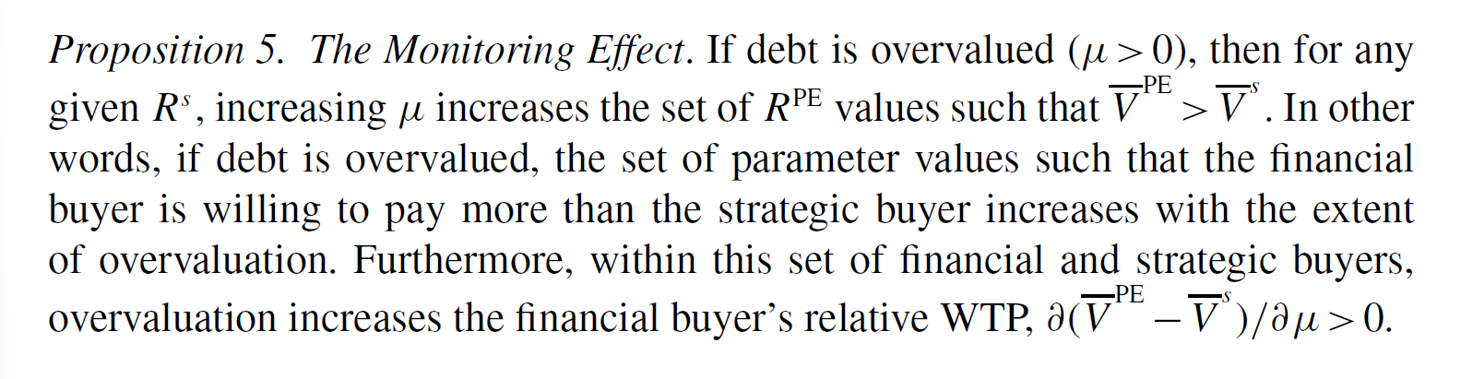
Explanation:
Because with overvaluation the perception of the moral hazard problem is better (Proposition 4), it implies that investors perceive the monitoring costs to be lower and thus perceive the total value creation of a financial buyer to be greater. This increases the investors’ willingness-to-lend to the financial buyer, which in turn both changes the set of PE firms that can win and increases their relative WTP.

Slide 15
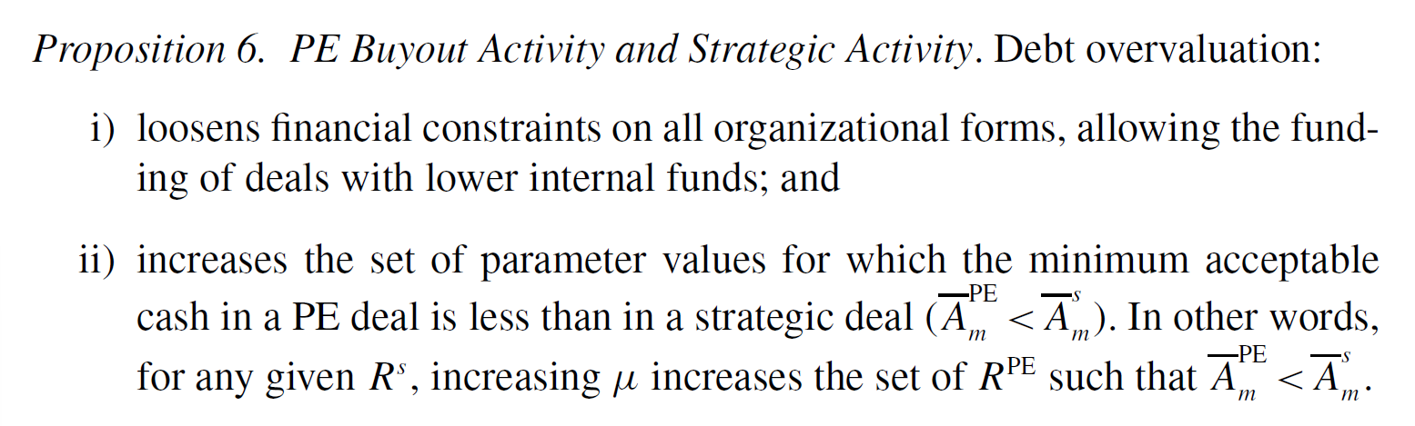
Explanation:
Overvaluation reduces the perception of moral hazard, therefore loosening the constraints on all types of organizational forms, but unambiguously increases PE activity.
The overvaluation’s extensive margin not only changes the ratio of financial to strategic acquirers but also increases overall acquisition activity.

Slide 16
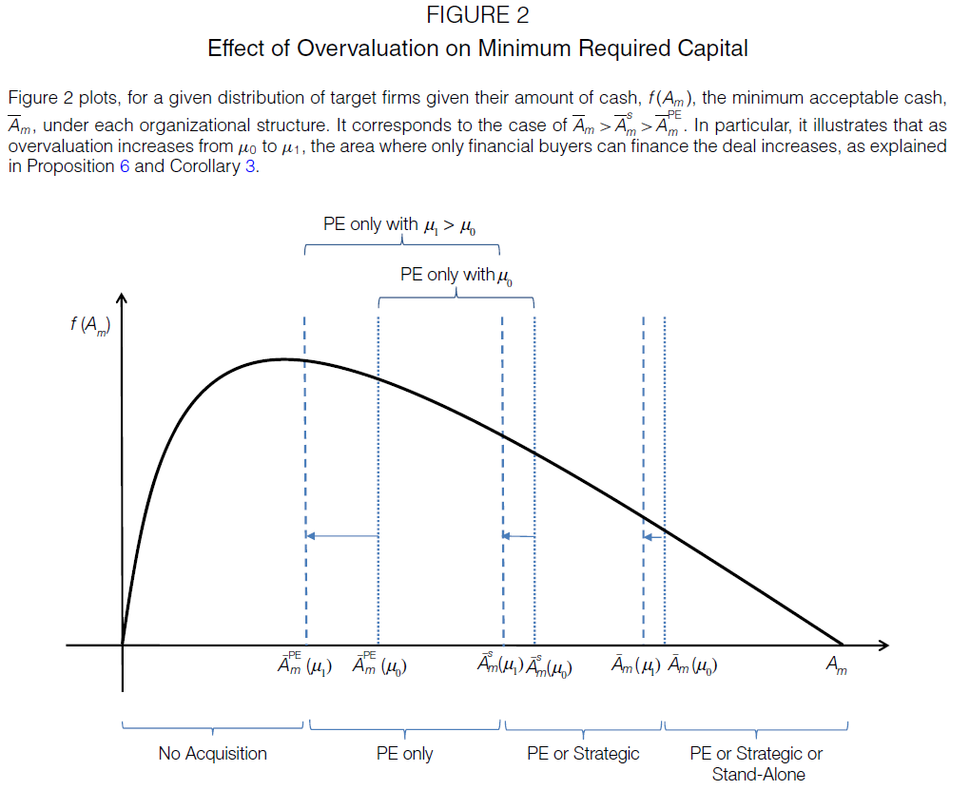

Slide 17
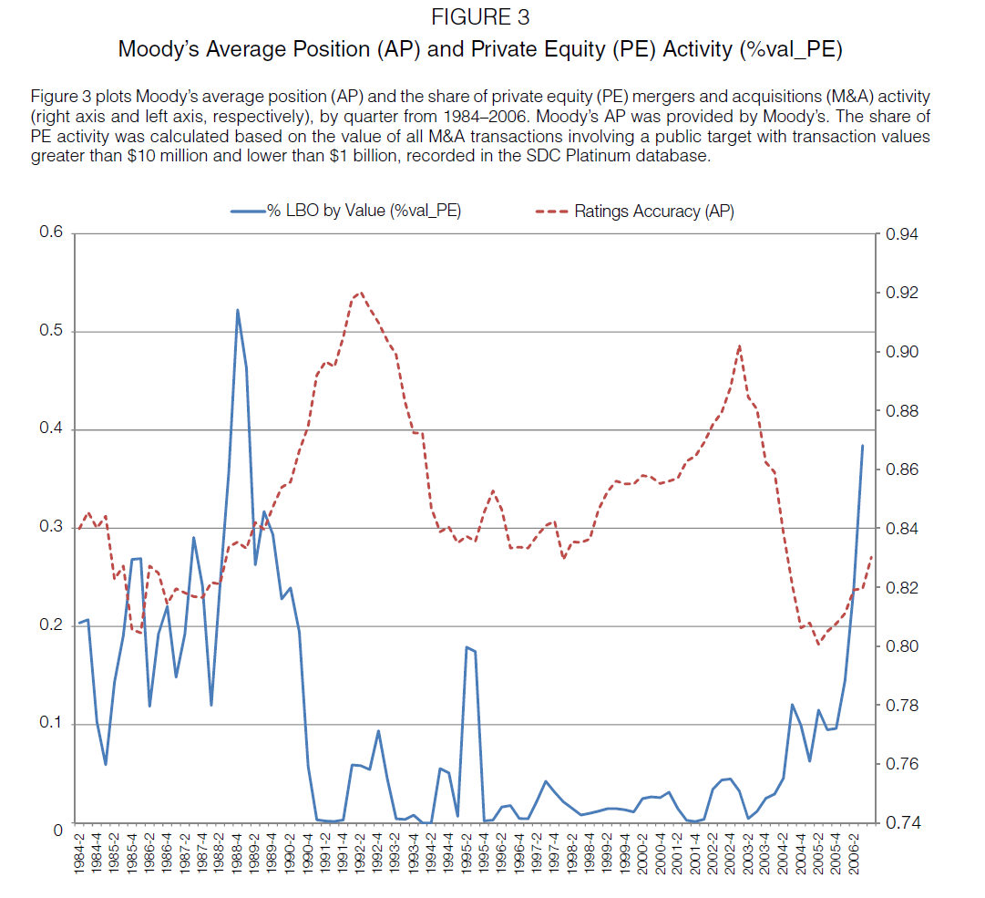
Notes:
Moody’s tracks the ex-post accuracy of its rating measures, using the so-called average position (AP).
If more defaulters were given higher ratings, the AP would fall.
Thus, the authors’ concept of overvaluation will be captured by lower average positions.
The authors’ measure of PE activity is the fraction of the value of all deals for public targets accounted for by financial sponsors.

Slide 18
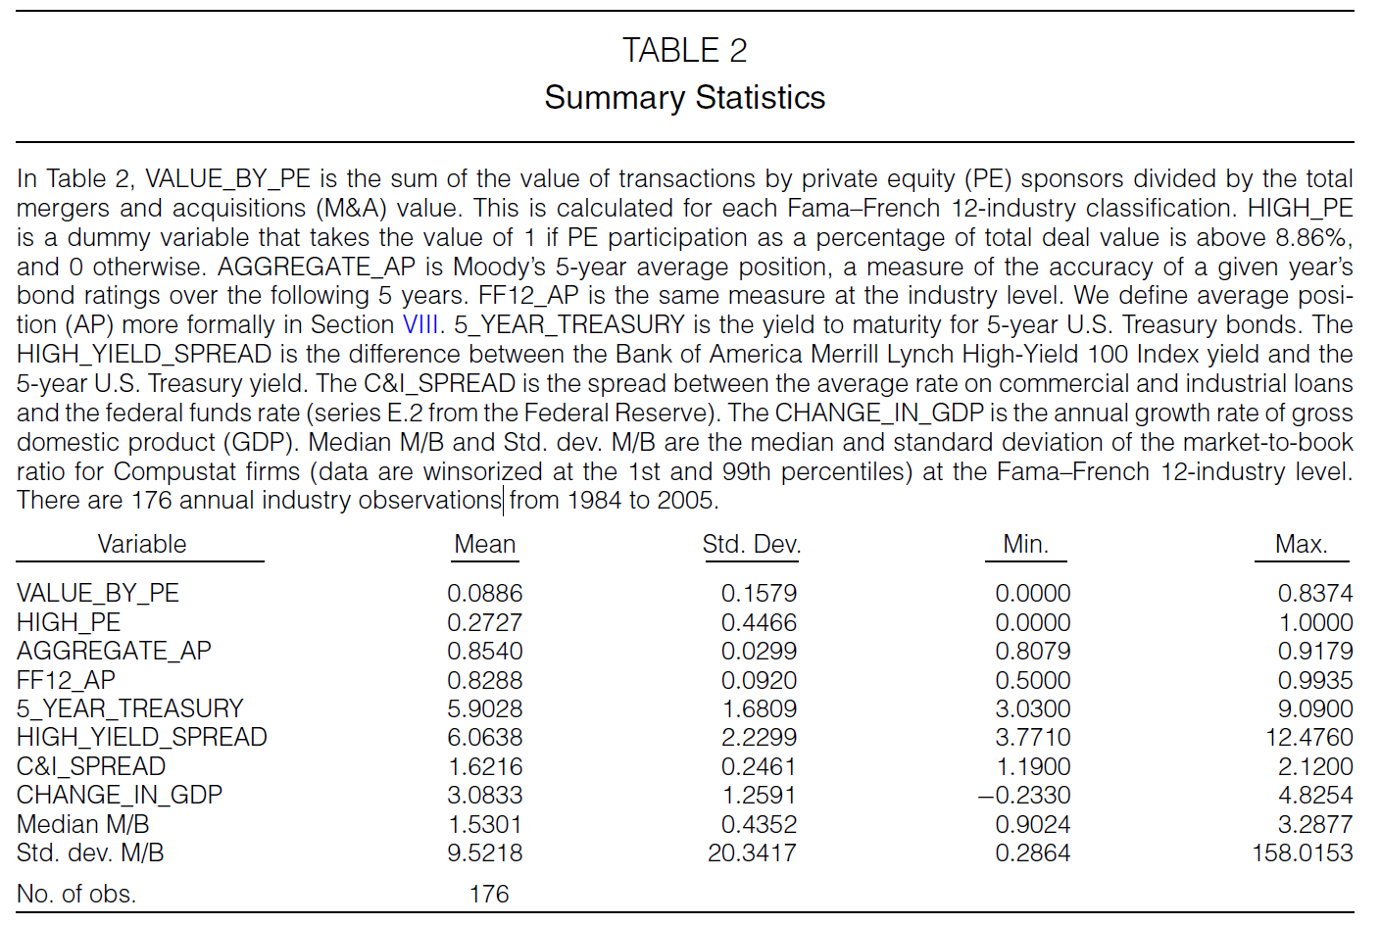
Notes:
The average fraction of activity accounted for by PE acquirers is 8.86%, and 27.27% of the years are high PE periods.
The aggregate average position fluctuates within a relatively tight range (between 81% and 92%), but expands at the industry level.
Controls

Slide 19
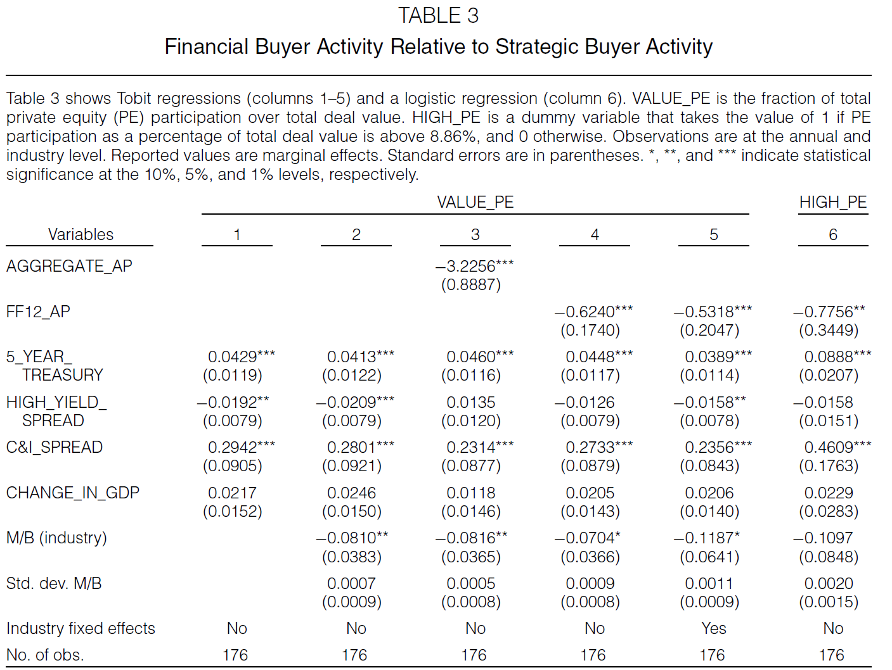
Notes:
Tobit regressions (columns 1-5) of the fraction of financial buyers, and logit regression (column 6) of a dummy variable that takes the value of 1 if PE participation is above average.
Columns 1 and 2: The high yield spread is negatively correlated with PE activity as in Harford (2005).
Column 3: The average position coefficient is significantly negative, confirming that in periods when overvaluation is high, PE activity increases as a fraction of total M&A activity.
A 1% decrease in aggregate AP increases the fraction of PE activity by 3.2%.
Columns 4 and 5: Still significant when using industry AP.
Column 6: For robustness—still significant when using logit regression with High PE dummy.

Slide 20
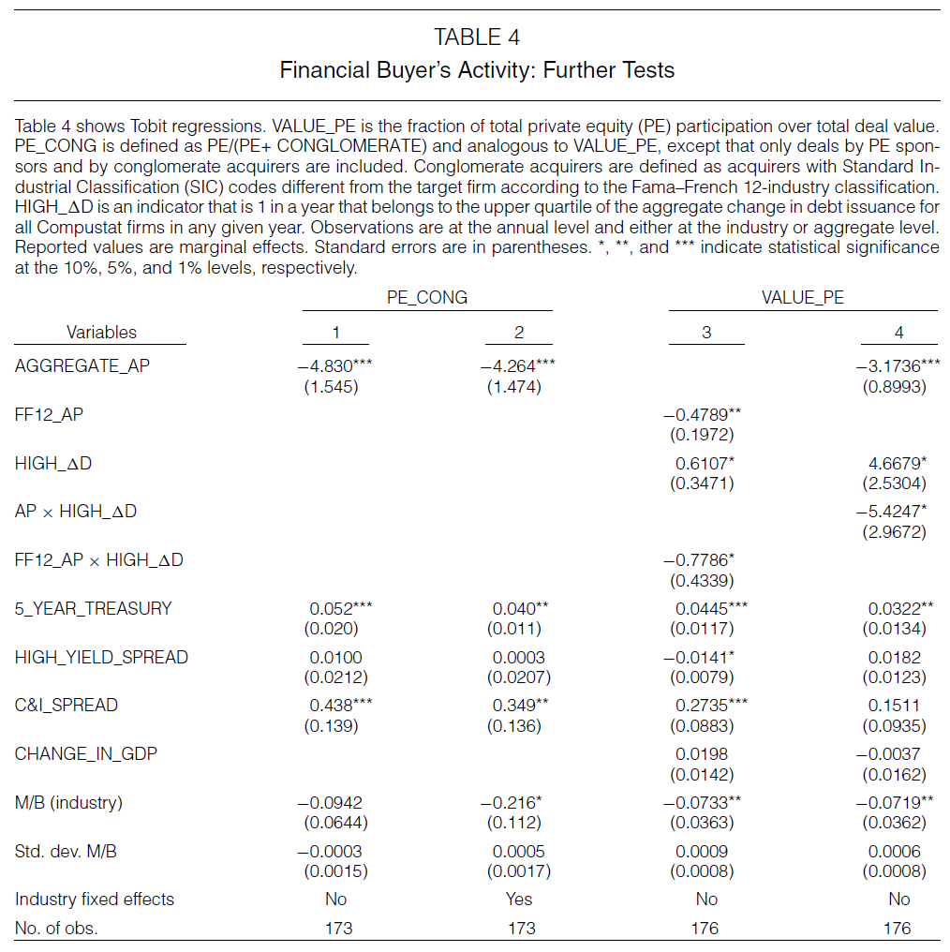
Notes:
Columns 1 and 2: The coinsurance effect shown in Corollary 2 predicts that a conglomerate acquirer should be even more impacted than a non-conglomerate acquirer in their relative ability to acquire.
A 1% decrease in AP increases the fraction PE/(PE+CONGLOMERATE) by 4.83%.
Columns 3 and 4: Proposition 6 and Corollary 3 predict that when parameters are such that the monitoring effect is relevant, misvaluation causes an increase in debt issuance.
When we see higher debt issuance, we should also expect the impact of misvaluation on PE’s ability to acquire a target to be even larger.
The interaction has a significantly negative sign and debt overvaluation and debt issuance are positively correlated.

Slide 21
Conclusion
Debt misvaluation significantly influences the ratio of financial buyers to strategic buyers in M&A.
In overvalued debt markets, financial buyers dominate relative to strategic buyers.
Debt market conditions change the ownership structure of assets and alter incentives and governance.
The paper highlights the importance of debt misvaluation in understanding M&A activity.

